Slide 1
Lecture 5
Over Fitting - Under Fitting - Regularization

Slide 2
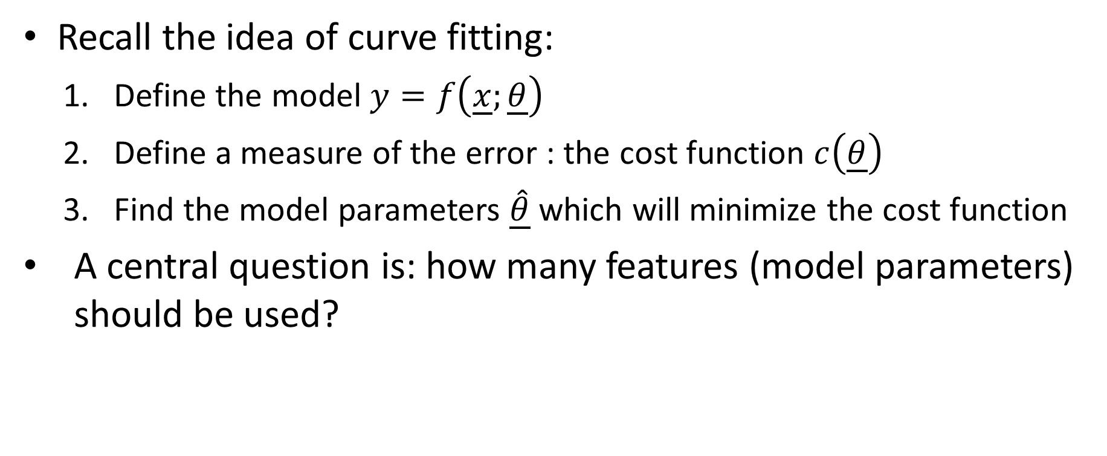
Introduction
Recall the idea of curve fitting:
Define the model $y=f\left(\underline{x};\underline{θ}\right)$
Define a measure of the error : the cost function $c\left(\underline{θ}\right)$
Find the model parameters $\underline{\hat{θ}}$ which will minimize the cost function
A central question is: how many features (model parameters) should be used?
Notes:
In previous lectures we discussed extensively how curve fitting is used as a machine learning algorithm to make predictions based on a data set
We learned that we need a model which depends on a set of model parameters, or so-called feature weights.
Once defined the measure of the error, or cost function, we know that we have to find the feature weights that will minimize this cost function.
You may think that one of the challenging part is to find an appropriate model. That is true, but there is another none trivial problem. How many features should be included in our model?
When handling large data set with complex relations, to select the correct number of features is indeed a very challenging problem in machine learning
We cannot discuss this problematic in detail. In this lecture we will give a first feeling about this problematic and we will discuss one tool, among many available in the arsenal of machine learning.

Slide 3







Introduction
$$y$$
$$y=θ_{0}+{θ_{1}x}_{1}$$
$$x_{1}=x$$
$$y=θ_{0}+{θ_{1}x}_{1}+{θ_{2}x}_{2}$$
$$x$$
$$x_{1}=x$$
$$x_{2}=x^{2}$$
Notes:
As illustration of the problematic of choosing the correct number of features, let us consider the data set illustrated on the displayed plot given some outputs y in function on some inputs x
Let us try to represent this set with a linear model involving a single feature $x_{1}=x$
The model writes $y=θ_{0}+{θ_{1}x}_{1}$
As can be observed on the plot, such linear relation doesn’t represent the data set well
Let us try a model involving two features. The first one is $x_{1}=x$ and the second one is $x_{2}=x^{2}$
The model writes $y=θ_{0}+{θ_{1}x}_{1}+{θ_{2}x}_{2}$
This model represent much better the data set as illustrated on the plot

Slide 4




Introduction
$$y$$
$$y=θ_{0}+{θ_{1}x}_{1}+…+{θ_{20}x}_{20}$$
$$x_{i}=x^{i}$$
$$x$$
Notes:
To use two features was kind of natural considering the general shape of the data set which suggests indeed a quadratic dependence of y in x
You may say: well what is the problem. If we don’t know exactly which dependence we have, can’t we simply include many features to be sure to have enough of them
For example 20 features defined as $x_{i}=x^{i}$ and the model would write $y=θ_{0}+{θ_{1}x}_{1}+…+{θ_{20}x}_{20}$.
In other words we attempt to fit a polynomial of degree 20
Trying to fit the data set with this model results however in a very poor fit as displayed on the graph
We discussed already a similar situation in the context of interpolation where we learned that having to high degree polynomials isn’t always a good idea
In fact in the context of curve fitting we have a similar effect

Slide 5
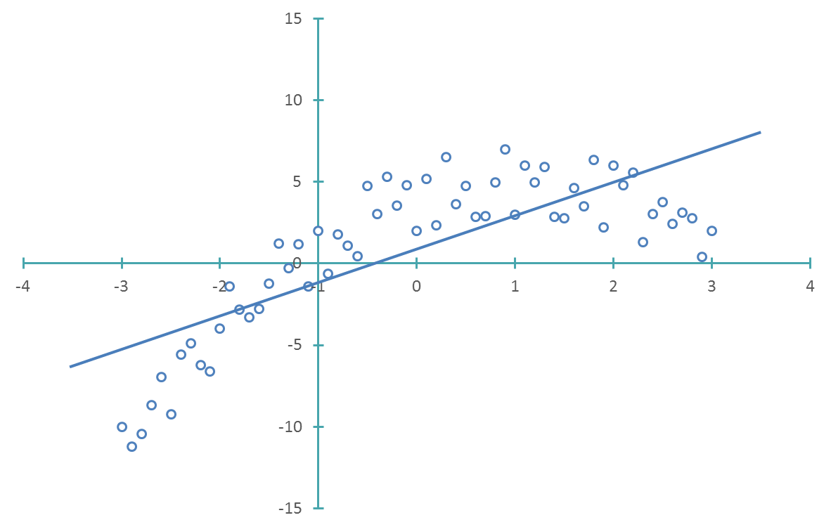
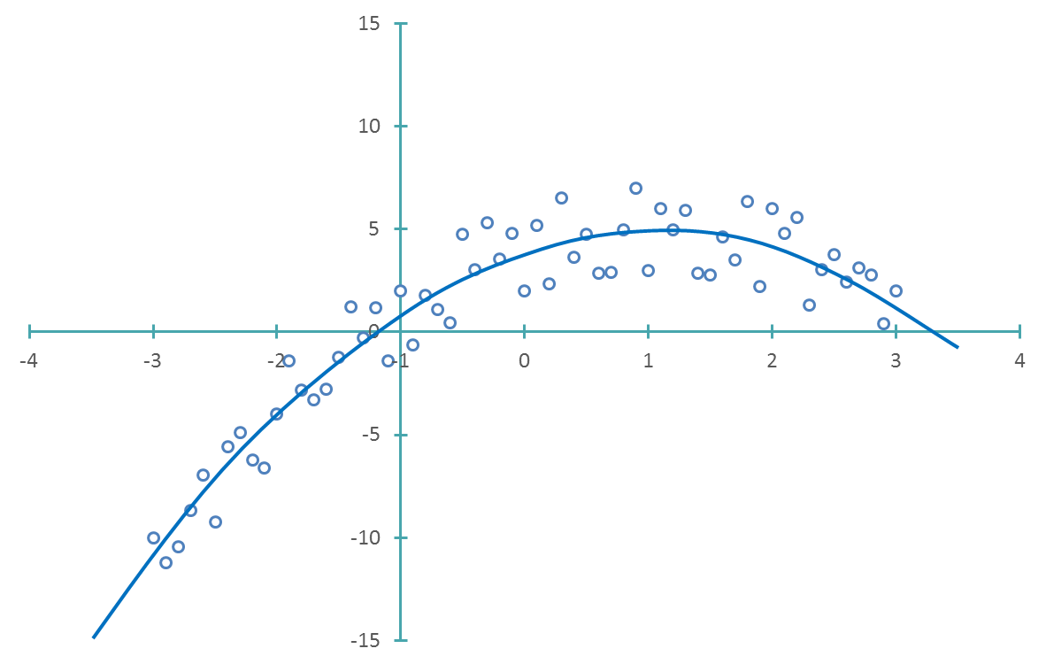
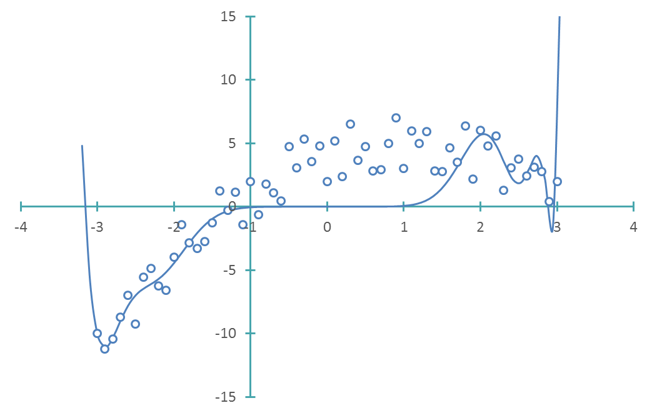









Introduction
Under-fit
Optimal -fit
Over-fit
$$y$$
$$y$$
$$y$$
$$x$$
$$x$$
$$x$$
RMSE$=3.0$
RMSE$=1.4$
RMSE$=4.1$
Notes:
Let us summarize the three case that can happen
First, we may use a model with too few features
In this case we say we do under-fitting
The model doesn’t have enough degree of freedoms to represent correctly the dependence of the output y in function of the input
On the other extreme, we may use a model with too many features.
In this case we say we do over-fitting
Now the model has too many degree of freedoms and the model will start to try to represent effects that actually do not exist
If we choose the optimal number of parameters then we say we get an optimal fit
In the case of our data set which can be represented in a x-y plot it can be right away seen from the plots in which case we are
But how can you handle a more realistic case wher you cannot represent the data set on 2 dimensional plots?
The tool we have available is to observe the evolution of the measure of the error, for example the root mean square error
If we compute the RMSE value of our there cases, you can note that indeed it is minimal for the case where the model has the optimal number of features
In machine learning there exist techniques based on observing the evolution of the RMSE, or other measures of the error, in function of the number of features used in the model. An example are the so-called learning curves. We won’t have time to discuss them in this course, but if you are curious I invite you to search on the internet or the library more about this concept. It isn’t very difficult to understand and you have most of the background needed for it

Slide 6
Regularization - Principle
For large data sets which are multi-dimensional choosing the correct number of features is a very challenging task
A tool to help in this is regularization
The idea is to modify the cost function to be minimized in regression:
Cost function = Norm of residuals + Norm of Feature weights
Notes:
For large data sets which are multi-dimensional choosing the correct number of features is a very challenging task
An interesting approach would be to have a tool that allows you to preform the fit with a large number of features, but somehow the fit should realize which features are important and which ones are too much
This approach exists and is called regularization
The idea is to modify the cost function to be minimized in regression
We add an additional term to the cost function and write it as the sum of the norm of the residuals and the norm of the feature weights
The norm of the residuals is what we used so far in our cost function. Minimizing this norm resulted in feature weights that minimize the residuals
The new term is the norm of the feature weights.
This term is added because we want that it is costly to find model parameters with large values. In this way we hope to eliminate the feature weights that are actually not needed to optimally represent the data set
Depending on how one defines the norm of the feature weights one will get different type of regularization cost functions
We will discuss three examples
For the example we discussed in previous slides we would like to have a way to use the model with the degree 20 polynomial but the fit should tell us that only the coefficient up to the quadratic term are important

Slide 7
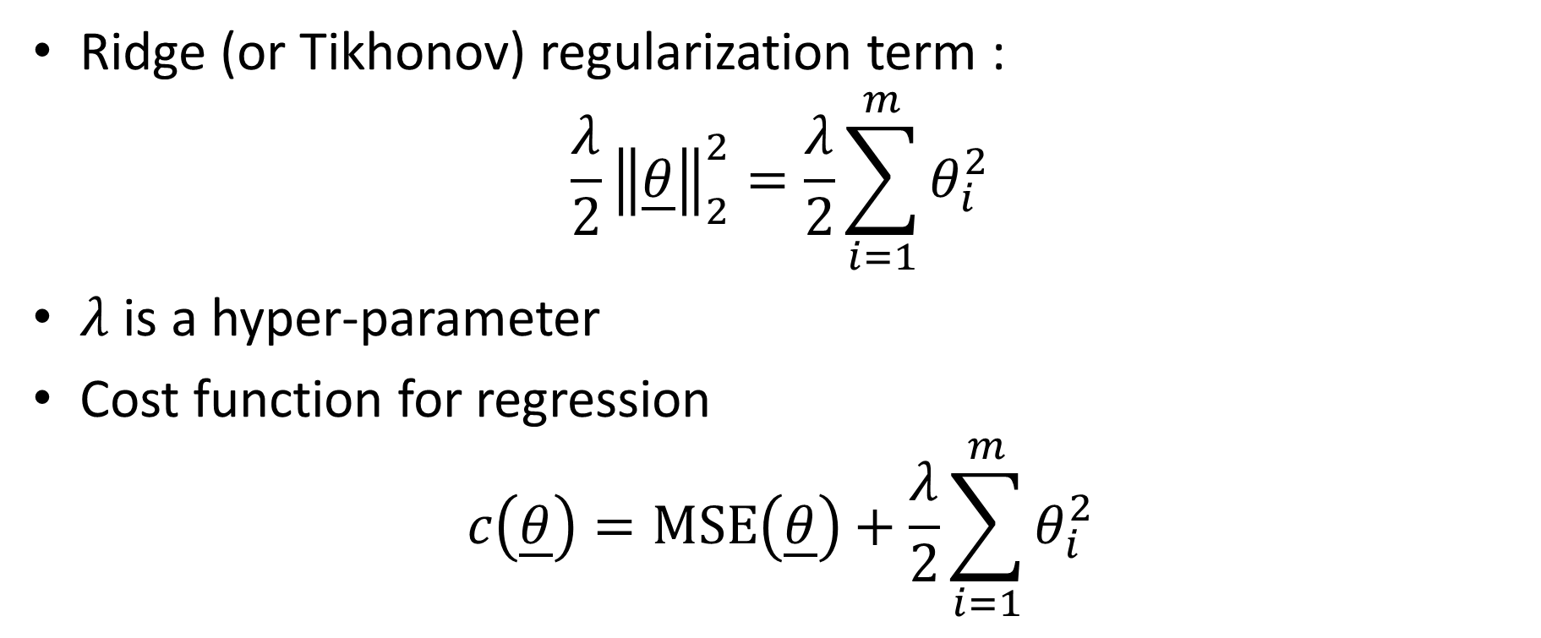
Ridge Regression
Ridge (or Tikhonov) regularization term :
$$\frac{λ}{2}{\left\|\underline{θ}\right\|}_{2}^{2}=\frac{λ}{2}\sum_{i=1}^{m}{θ_{i}^{2}}$$
$λ$ is a hyper-parameter
Cost function for regression
$$c\left(\underline{θ}\right)=\text{MSE}\left(\underline{θ}\right)+\frac{λ}{2}\sum_{i=1}^{m}{θ_{i}^{2}}$$
Notes:
The first example is the so-called Ridge (or Tikhonov) regularization
Here the 2-norm, or Euclidean norm is used
A parameter $λ$ is further introduced
This is a hyper-parameter which will have to be chosen when we use the ridge regression.
The factor ½ is usually added for reasons that we will not discuss here
The cost function used in ridge regression is then typically
$$c\left(\underline{θ}\right)=\text{MSE}\left(\underline{θ}\right)+\frac{λ}{2}\sum_{i=1}^{m}{θ_{i}^{2}}$$

Slide 8
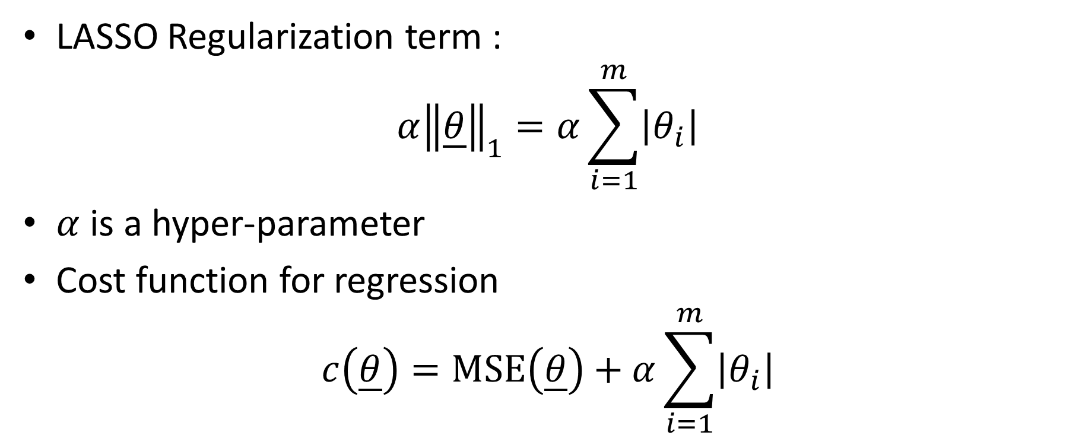
LASSO Regression
LASSO Regularization term :
$$α{\left\|\underline{θ}\right\|}_{1}=α\sum_{i=1}^{m}{\left|θ_{i}\right|}$$
$α$ is a hyper-parameter
Cost function for regression
$$c\left(\underline{θ}\right)=\text{MSE}\left(\underline{θ}\right)+α\sum_{i=1}^{m}{\left|θ_{i}\right|}$$
Notes:
The second example is the LASSO regression
The LASSO Regularization term is based on the 1-norm of the feature weights
A parameter $α$ is further introduced
This is a hyper-parameter which will have to be chosen when we use the LASSO regression.
The cost function used in LASSO regression is then typically
$$c\left(\underline{θ}\right)=\text{MSE}\left(\underline{θ}\right)+α\sum_{i=1}^{m}{\left|θ_{i}\right|}$$

Slide 9
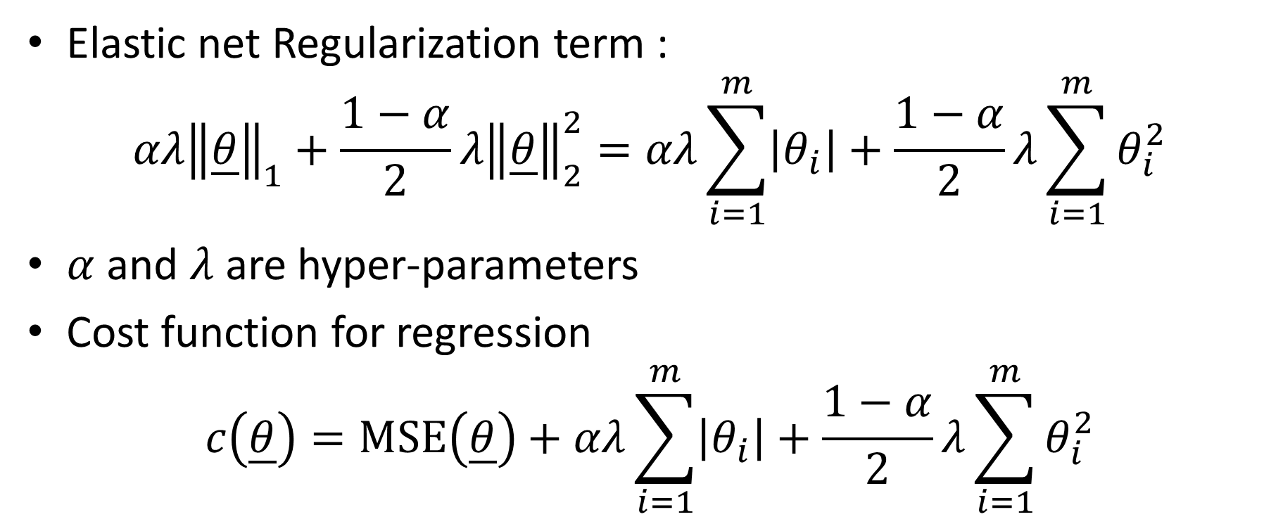
Elastic net Regression
Elastic net Regularization term :
$$αλ{\left\|\underline{θ}\right\|}_{1}+\frac{1−α}{2}λ{\left\|\underline{θ}\right\|}_{2}^{2}=αλ\sum_{i=1}^{m}{\left|θ_{i}\right|}+\frac{1−α}{2}λ\sum_{i=1}^{m}{θ_{i}^{2}}$$
$α$ and $λ$ are hyper-parameters
Cost function for regression
$$c\left(\underline{θ}\right)=\text{MSE}\left(\underline{θ}\right)+αλ\sum_{i=1}^{m}{\left|θ_{i}\right|}+\frac{1−α}{2}λ\sum_{i=1}^{m}{θ_{i}^{2}}$$
Notes:
The third example we present is the elastic net regression
Elastic net regularization combines ridge and LASSO regularization
It uses consequently two hyper-parameters $α$ and $λ$
They measure the weight given to the contribution from the ridge and LASSO regression
For example for $α=1$ the elastic net term is the same as the LASSO regularization term
On the other extern, $α=0$ results in the ridge regression
The elastic net cost function is usually defined as displayed on the screen

Slide 10
Implementation in Matlab
Matlab provides a function implementing these regularization methods:
We present this function in the following format:
[B, fitinfo] = lasso(x,y)
B : returns fitted regression parameters
fitinfo: contains various information about the fit
x : a matrix containing all features column by column [x1 x2 … ]
y : labels of data organized in a column vector
Notes:
We will not discuss how curve fitting with regularization is implemented as an algorithm. Such algorithm are not trivial and would require quite a bit of fundamental developments
However we will explain how you can use the in-built matlab function lasso
Note that octave does not yet implement this function even it is planned to be implemented
The matlab function lasso can be used in various ways.
The way we discuss is when it is fed with two arguments and two return values are captured
The vector B returns fitted regression parameters
The matlab structure fitinfo contains various information about the fit
The arguments of lasso are the vectors x and y
X is a matrix containing all features column by column [x1 x2 … ]
And y is a column vector with all labels of the data set

Slide 11

Example
Data set: nearly linearly depended points according $y=4x+2$
>> x=linspace(-3,3)';
>> y = [x.^0 x.^1]*[2 4]’+ randn(length(x),1)*2;
>> plot(x,y, ’o’)
Notes:
Let us workout an example to illustrate how you can use the lasso function
First we will generate a data set
We want ot generate a data set which is nearly linear according the equation $y=4x+2$
We proceed as follows
First we define a x vector with the command x=linspace(-3,3)‘
The command linsapce will generate 100 equally spaced points between -3 and 3 and arrange them in a line vector
As we want a column vector for x we added the apostrof to transpose the line vector into a column vector
To generate the y values, or labels, of the data set we use two tricks
First we calculate y = [x.^0 x.^1]*[2 4]’
This computes the y values of each entry of the x vector according the equation 2+4x
If you have troubles to understand this trick, I recommend you to write down this matrix equation on a piece of paper
If you understood well the notations we used in the second lecture of this lesson then it should clear for you. If not, I suggest you review this lecture again
The second term we add is with the randn function
The randn function generates random numbers organized in a matrix
The random numbers are of mean zero and standard deviation one
The first argument tells how many numbers you want. This will be the number of lines of the matrix generated
In our case we want length(x) numbers, which means the same numbers as we have in the x vector.
The second argument is how many columns you want in your matrix. In our case we want only one column
Adding these two terms calculates y values following the equation 4x+2 but with some noise added to it. We multiplied by two the noise to make it a little larger than of standard deviation one
With command plot we can visualize the generated data set x-y
We get indeed some points fooling the equation 4x+2 but with some noise added to it

Slide 12
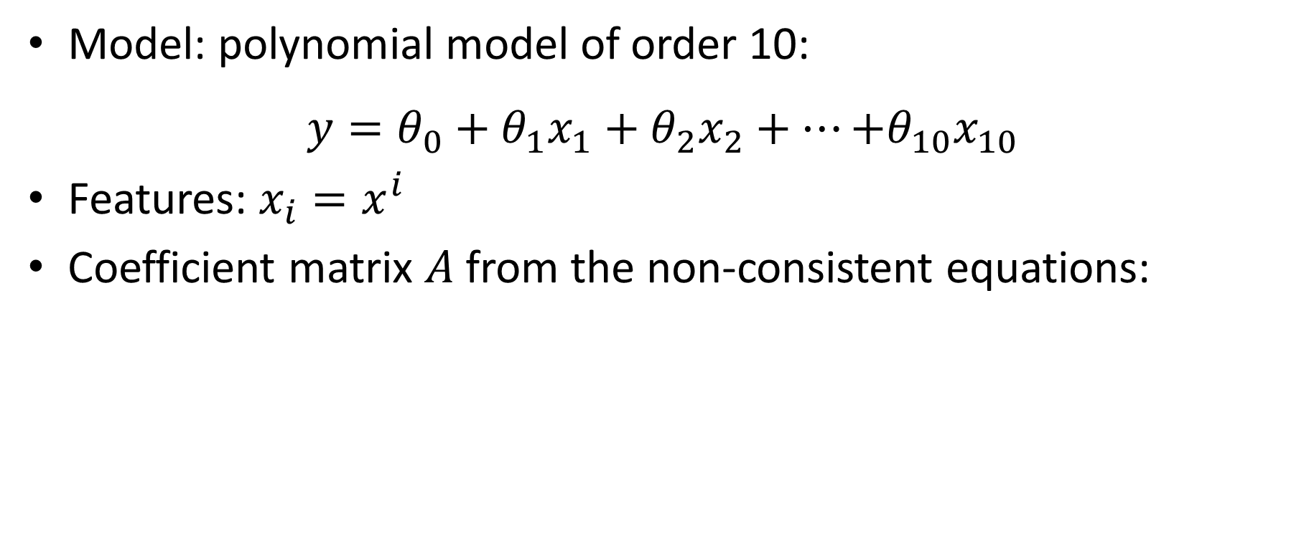
Example
Model: polynomial model of order 10:
$$y=θ_{0}+{θ_{1}x}_{1}+{θ_{2}x}_{2}+…{+θ_{10}x}_{10}$$
Features: $x_{i}=x^{i}$
Coefficient matrix $A$from the non-consistent equations:
>> A=[x.^0 x.^1 x.^2 x.^3 x.^4 x.^5 x.^6 x.^7 x.^8 x.^9 x.^10];
Notes:
Let us now choose a model
We choose to fit a polynomial of degree 10
We do this by defining a linear model with ten features xi defined as $x_{i}=x^{i}$
In a first step we will use the normal equations to find the model parameters
For this we need the coefficient matrix A from the non-consistent equations
We define it the way we learned in previous lectures by using the column by column method
The first column is made of ones, which we achieve by taking the power zero of the vector x
The second column contains the first feature, which is x
The third column contains the second feature, which is x power 2
We proceed lie this until the last column which is the last feature x10 which is equal to x power 10

Slide 13
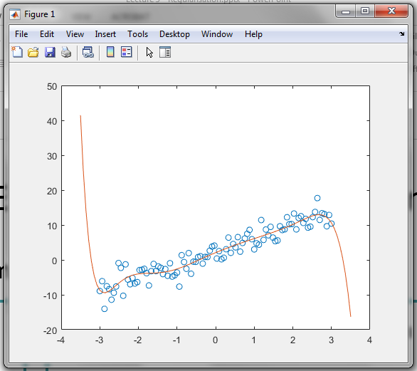
Example
Fitting by normal equations
>> theta=A'*A\A'*y
theta =
2.0806
4.6006
-0.6854
-0.0968
0.3981
-0.1976
-0.0274
0.0530
-0.0053
-0.0035
0.0005
>> xf=[linspace(-3.5,3.5)'];
>> yfit=[xf.^0 xf.^1 xf.^2 xf.^3 xf.^4 xf.^5 xf.^6 xf.^7 xf.^8 xf.^9 xf.^10]*theta;
>> plot(x,y,'o',xf,yfit)
Notes:
We solve the normal equations using PA=LU decomposition and store the computed model parameters in the vector theta
Note that if you try to reproduce this example on your computer you will get different values are the y values you will have generated will most likely differ
To plot the fitted model we can compute the predicted values y of the fitted model corresponding to some x values
We call these x values xf and choose them between -3.5 and +3.5
To compute the corresponding y values we compute A times theta where A is the matrix obtained from our values xf and theta the fitted model parameters
Using the plot command we can visualize our data set and the fitted model
We note that the fit isn't that great, especially at start and end of the data set

Slide 14

Example
Using LASSO regression
>> [B, fitinfo] = lasso([x.^1 x.^2 x.^3 x.^4 x.^5 x.^6 x.^7 x.^8 x.^9 x.^10],y);
>> size(B)
ans =
10 100
>> B(:,5)
ans =
4.9109
-0.1641
-0.7239
0.1953
0.0989
-0.0213
0.0039
-0.0006
-0.0009
0.0001
$$\underline{θ}=\left[\begin{matrix}θ_{0} \\ \begin{aligned}θ_{1} \\ θ_{2} \\ ⋮\end{aligned} \\ θ_{10}\end{matrix}\right]=\left[\begin{matrix}θ_{0} \\ \begin{aligned}\text{4.9109 } \\ \text{−0.1641} \\ ⋮\end{aligned} \\ \text{0.0001} \end{matrix}\right]$$
Notes:
Let us repeat the same fit but using LASSO regression
For this we use the matlab lasso function
The two input arguments of the function are the features and the labels
The matlab function will return us a matrix B and a matlab structure fitinfo
Let us first focus on the matrix B
Executing size(B) reveals us that it is a 10 by 100 matrix
How should we understand this matrix B?
In fact each column of the matrix B contains a set of fitted model parameters theta
For example, B(:,5) is the column number 5. It contains 10 fitted model paramters theta1 to theta10
Note that the bias term $θ_{0}$ is not encoded inside this matrix
What are the different columns?
Each column was generated with a different hyper-parameter lambda
In the simple form of the function lasso we present here, matlab chooses a range of hypermeters for you. If you are curious you can read the online documentation from matlab on the lasso function to learn how to force to chose yourself these hyper-parameters

Slide 15


Example
To find $θ_{0}$, the intercept, we need to look at the Matlab structure fitinfo returned by the lasso function
>> fitinfo
fitinfo =
struct with fields:
Intercept: [1×100 double]
Lambda: [1×100 double]
Alpha: 1
DF: [1×100 double]
MSE: [1×100 double]
PredictorNames: {}
>> fitinfo.Intercept(5)
ans =
1.9003
$$\underline{θ}=\left[\begin{matrix}θ_{0} \\ \begin{aligned}θ_{1} \\ θ_{2} \\ ⋮\end{aligned} \\ θ_{10}\end{matrix}\right]=\left[\begin{matrix}1.9003 \\ \begin{aligned}\text{4.9109 } \\ \text{−0.1641} \\ ⋮\end{aligned} \\ \text{0.0001} \end{matrix}\right]$$
Notes:
To find $θ_{0}$, the intercept, we need to look at the Matlab structure fitinfo returned by the lasso function
You can note that fitinfo contains several info
Among others the intercepts, which we will use shortly, but as well the hyper-parameters lambda that correspond to each column of the matrix B
To get the intercept $θ_{0}$ of the column number 5 you use the syntax fitinfo.Intercept(5)
Note the capital i of the word intercept. You have to respect this convention.
This allows us find the full fitted feature weight vector

Slide 16
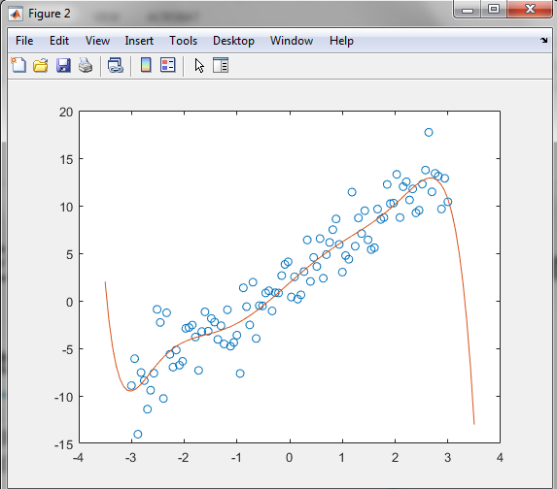
Example
Plotting the fitted model
>> xf=[linspace(-3.5,3.5)'];
>> A=[xf.^0 xf.^1 xf.^2 xf.^3 xf.^4 xf.^5 xf.^6 xf.^7 xf.^8 xf.^9 xf.^10];
>> theta=[fitinfo.Intercept(5); B(:,5)]
>> yfit=A*theta;
>> plot(x,y,'o',xf,yfit)
Notes:
We can now plot the fitted model for this fitted model parameters
We proceed as usualy
First we choose some values xf where we want to compute the fitted model.
Here we choose 100 values between -3.5 and +3.5
Then we build the matrix A
Extract the feature weights suing the fitinfo structure and matrix B.
Here we decided to try the fitted values of column number 5
Then we compute the fitted y values yfit
And finally plot the data set and fitted model with the plot command
The fit doesn’t look very impressive. Maybe a little better than the one we got form the normal equations, but not really significantly better

Slide 17
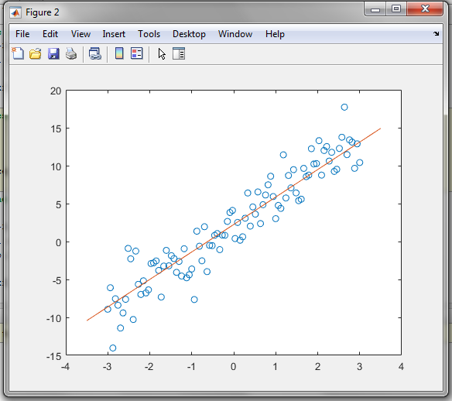
Example
Plotting the fitted model
>> xf=[linspace(-3.5,3.5)'];
>> A=[xf.^0 xf.^1 xf.^2 xf.^3 xf.^4 xf.^5 xf.^6 xf.^7 xf.^8 xf.^9 xf.^10];
>> theta=[fitinfo.Intercept(65); B(:,65)]
>> yfit=A*theta;
>> plot(x,y,'o',xf,yfit)
Notes:
But recall that matlab did in fact compute fitted feature weights for a range of hyper-parameters.
So let us try out another one than column 5.
Here we try column 65
We proceed same way as before
The resulting fit is now definitively better
The LASSO regression was able to keep only the first feature x1 and did put to zero all feature weights of the higher features x2 to x10
This example illustrates that it is possible, when playing with the hyper-parameter of the LASSO regression to obtain optimal fits even when we use too many features
Of course the question remains how to choose the correct hyper-parameter
In this course where we present only a first introduction to machine learning we don’t have the needed time to deepen that question.
So the only way we have currently is to use trial and error

Slide 18
Summary
Depending on the number of features of a model, one may obtain
Under-fitting, if the model contains too few features
Over-fitting, if the model contains too many features
Optimal-fit if the model contains the optimal number of features
Choosing the optimal number of features is very challenging
Regularization is a technique that can help to reduce the effect of the features that should normally not be in the model
Matlab has an in-built function lasso to implement LASSO regularization
Notes:
Let us summarize the key findings
Depending on the number of features of a model, one may obtain
- Under-fitting, if the model contains too few features
- Over-fitting, if the model contains too many features
- Optimal-fit if the model contains the optimal number of features
Choosing the optimal number of features is very challenging
Regularization is a technique that can help to reduce the effect of the features that should normally not be in the model
Matlab has an in-built function lasso to implement LASSO regularization

